Slide 1
Generating Insights from Clustering Large Donors
Brad Stieber Data Analyst, Wisconsin Foundation and Alumni Association Brad.Stieber@supportuw.org | bgstieber.github.io

Slide 2
Overview
Background
Large Donor Disruption
What is Unsupervised Learning
Three Clustering Algorithms
An Example from WFAA
Wrapping Up
Notes:
First, provide some information about my background, then lay the foundation for talking about UL, and finally discuss
How we’ve used it at WFAA to cluster our large donors, and why that group is so important

Slide 3
About Me
Data Scientist with experience in private finance, non-profit, and law enforcement
Passionate about communicating quantitative information effectively
Main tools are R, SQL, and Tableau
Frequently quote Box, Tukey, and Wickham
All models are wrong, but some are useful.
George Box
The best thing about being a statistician is that you get to play in everyone’s backyard.
John Tukey
Tidy datasets are all alike, but every messy dataset is messy in its own way.
Hadley Wickham

Slide 4
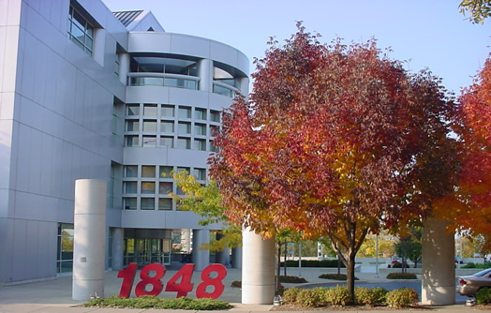

About WFAA
Official fundraising and gift-receiving organization for the UW–Madison
In the midst of a $3.2B campaign, ending in 2020
Staff of 300: 70 development officers, 13 in Data Solutions Team (DW, BI, DA), 13 in Research

Slide 5
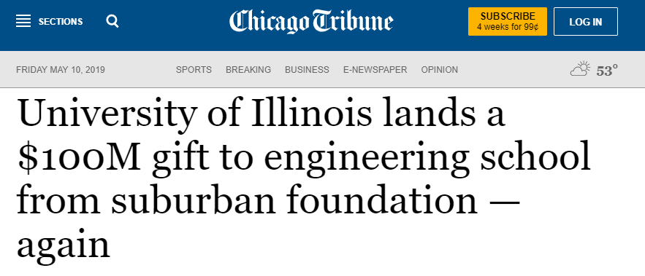
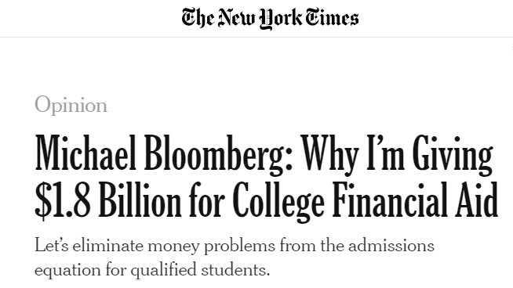
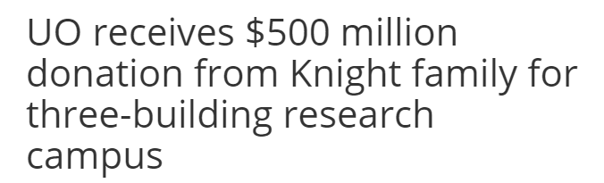
Large Donor Disruption – Overview
Growing wealth inequality
Deviation from 80/20
Large gifts in the news
Insights from Wealth-X’s World Ultra Wealth Report (2018):
Philanthropic activity is now one of the main interests of the ultra wealthy.
The Giving Pledge points to an increasing awareness that the ultra wealthy need to be seen to be giving something back to society.
There is a growing popularity of alternative methods of philanthropy, such as donor-advised funds and impact investment vehicles.

Slide 6
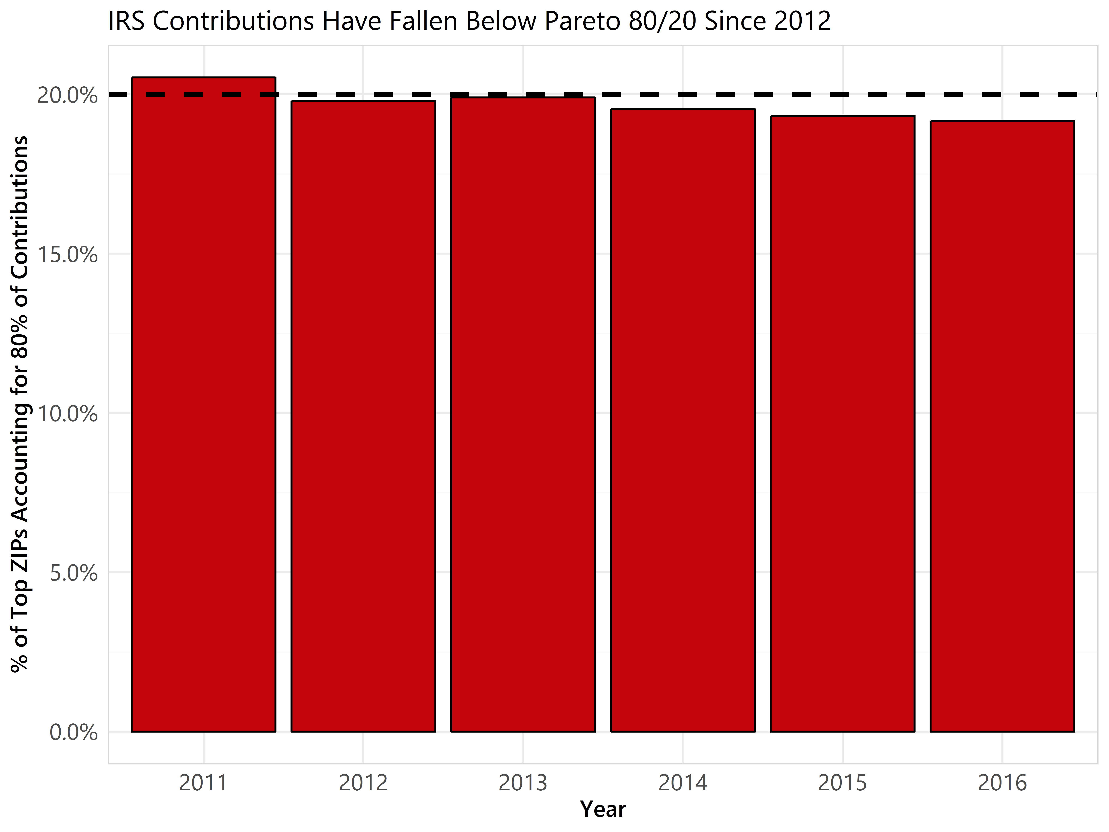
Large Donor Disruption – IRS Data
Tax return data is available by ZIP
How does the 80/20 “rule” hold up using charitable contributions on tax returns?
What does this tell us about large donors?

Slide 7
Large Donor Disruption – WFAA Data

Slide 8
Large Donor Disruption – Opinions
Large donors have always been important, but their importance is increasing
Also evident in HRC 2016 campaign contributions
Most organizations will have good data on these individuals, but might lack ways of analyzing it
What’s the dependent variable?
What you learn about large donors today will help you tomorrow

Slide 9
Unsupervised Learning
We have X (data set), but no y for classification or regression
What can we learn about the underlying structure of the data?
Great for data exploration and initial analyses, but sometimes difficult to generate out-of-sample predictions
y | X
Species | Sepal.Length | Sepal.Width | Petal.Length | Petal.Width
versicolor | 6 | 2.2 | 4 | 1
versicolor | 6.1 | 2.8 | 4 | 1.3
setosa | 5.1 | 3.8 | 1.9 | 0.4
setosa | 5.2 | 3.4 | 1.4 | 0.2
virginica | 6.3 | 2.7 | 4.9 | 1.8
X
Girth | Height | Volume
10.8 | 83 | 19.7
16 | 72 | 38.3
12.9 | 85 | 33.8
10.5 | 72 | 16.4
11 | 75 | 18.2
Supervised learning (iris):
predict y from X
Unsupervised learning (trees):
learn some structure about X

Slide 10
Using UL: Right and Wrong Times

Slide 11
Three Clustering Techniques You Should Know
K-Means
Hierarchical Clustering
DBSCAN
Bonus: Dimensionality Reduction
Notes:
DBSCAN-Density-based spatial clustering of applications with noise

Slide 12
K-Means
“Hello, world” of clustering algorithms
Simple, yet effective
Need to specify number of clusters, many methods for determining optimal number of clusters, but depends on context
Scale your data!
Be prepared to interpret the results

Slide 13
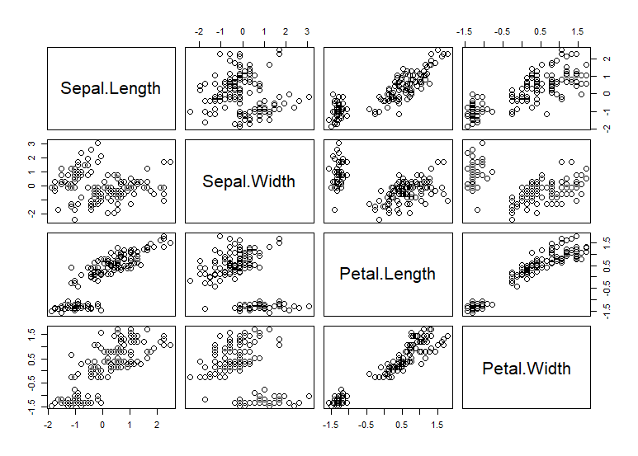
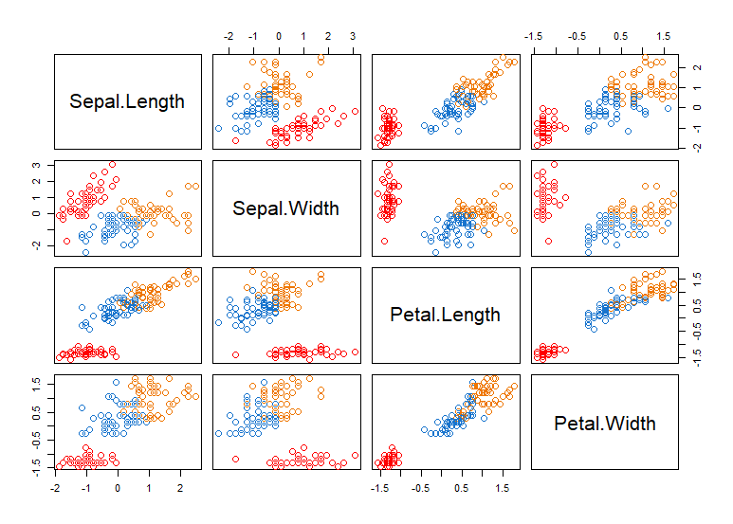
K-Means Example

Slide 14
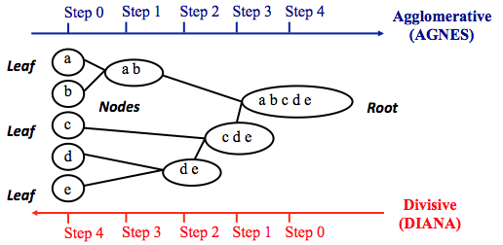
Hierarchical Clustering
Control of how high or low you go on a hierarchy
Does your data have a latent hierarchical structure?
Learn to interpret and explore a dendrogram
More flexible than K-Means, but harder to generate predictions
https://uc-r.github.io/hc_clustering
Notes:
Note that agglomerative clustering is good at identifying small clusters. Divisive hierarchical clustering is good at identifying large clusters.

Slide 15
Hierarchical Clustering Example

Slide 16
DBSCAN
More advanced than K-Means or hierarchical clustering
Useful in outlier detection and is flexible with respect to cluster shape
DBSCAN is “region-based”, trying to identify neighborhoods of densely packed data points
Don’t specify number of clusters, but need to specify epsilon (radius) and minimum points (number of neighbors to be a core point)
Implementations in R and Python
Notes:
DBSCAN-Density-based spatial clustering of applications with noise

Slide 17
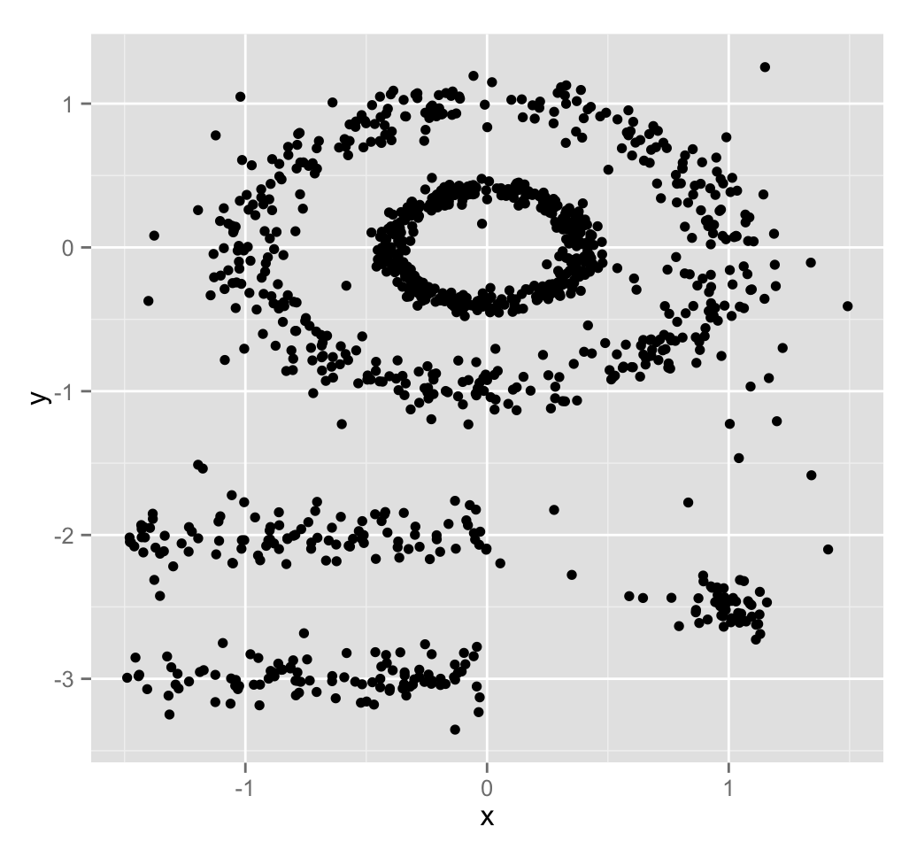
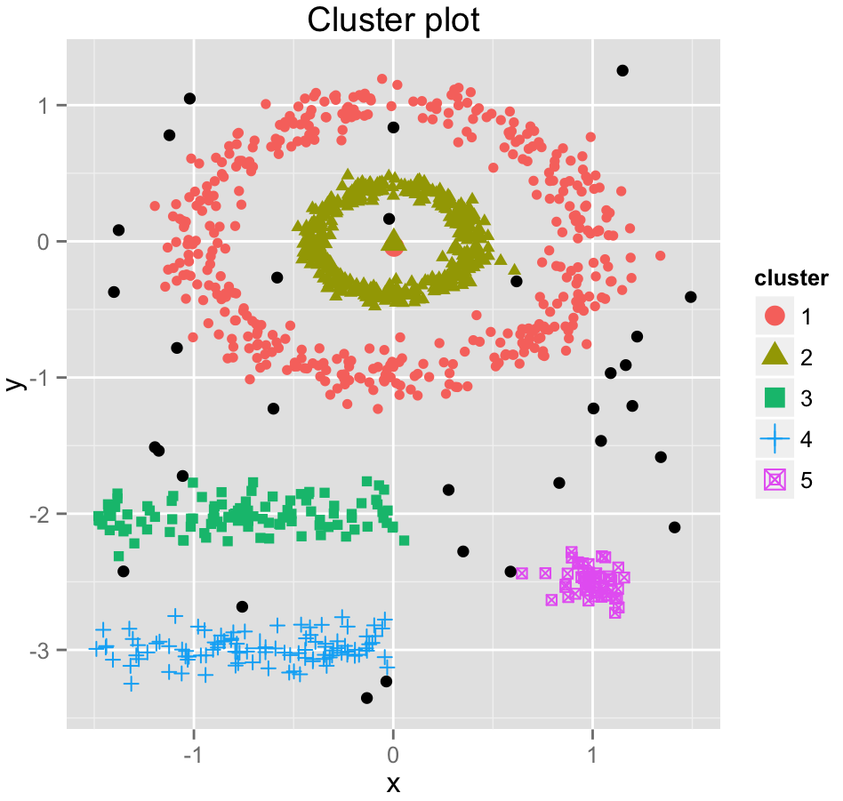
DBSCAN Example
http://www.sthda.com/english/wiki/wiki.php?id_contents=7940

Slide 18
Bonus: Dimensionality Reduction
Large number of data features (columns) makes standard data exploration hard
Redundancy or correlation between variables will affect machine learning algorithms
Helpful for unstructured data (i.e. sparse feature space)
Techniques
Principal component analysis (“hello, world” of dimensionality reduction)
t-SNE (more advanced algorithm, lots of cool examples on the web)
LASSO (for regression tasks)
By document word2vec summaries

Slide 19
Example from WFAA – Setup
Analytics FAQ
What other donors looks like X? Pathways?
Exploratory analysis on trajectories for large donor society
What else can we learn about these donors?
Nothing to predict, what can we do?

Slide 20
Example from WFAA – Data/Methods
1,150 Households with at least $250K in new gifts and new pledges
Giving is adjusted for inflation (2016 $)
At least one member of household must have valid birth year
At least one member of household must be living, or if all members are deceased, at least one member must have valid death year
Lifetime giving
First gift amount
Most recent gift amount
Giving in first five years of giving career
Giving in last five years of giving career
Count gifts
Largest gift
Age at first gift
Age at most recent gift
Age at largest gift
Age at passing $250K threshold
Days between first gift and passing $250K threshold
Notes:
This top donor group represented about 0.6% of all eligible donors…accounted for 75% of dollars

Slide 21
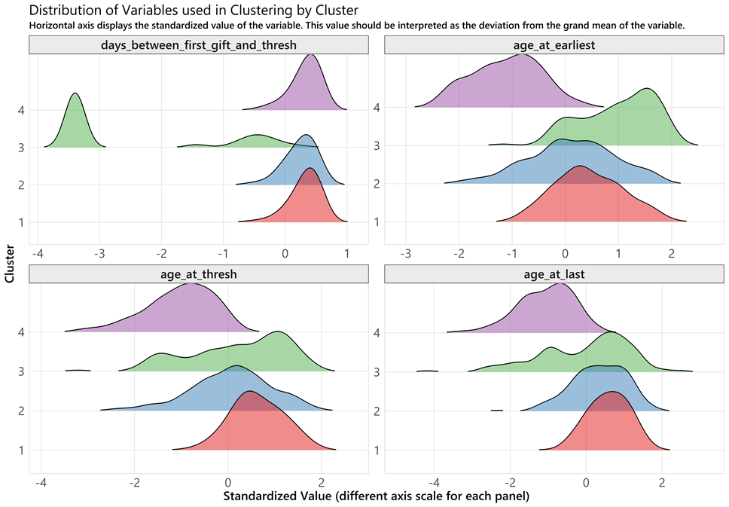
Example from WFAA – Results
Used K-Means on scaled data (log almost everything!)
Found four distinct and interpretable clusters
Cluster 4: Young Whippersnappers (327)
Cluster 3: Take the Money and Run (or Walk) (127)
Cluster 2: Big Kahuna (217)
Cluster 1: Oldie but a Goodie (478)

Slide 22
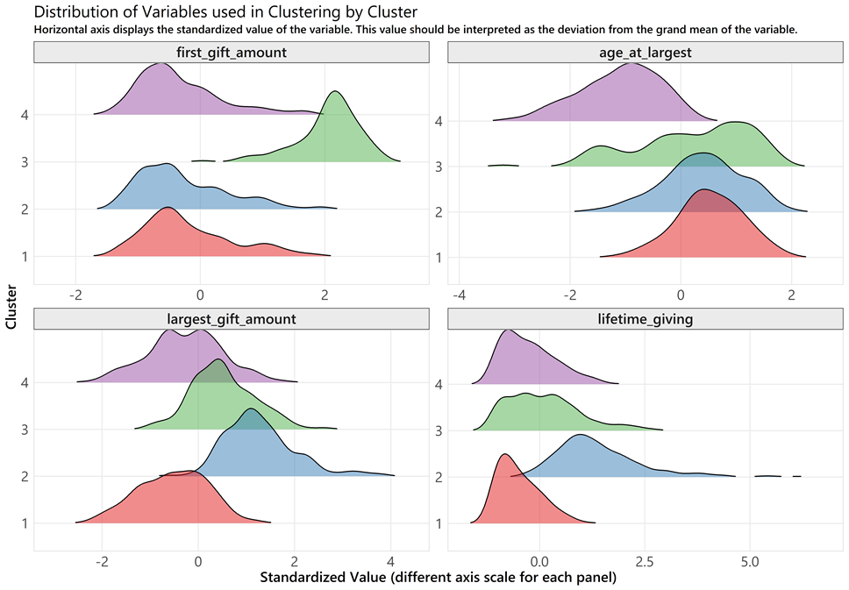
Example from WFAA – Results
Used K-Means on scaled data (log almost everything!)
Found four distinct and interpretable clusters
Cluster 4: Young Whippersnappers (327)
Cluster 3: Take the Money and Run (or Walk) (127)
Cluster 2: Big Kahuna (217)
Cluster 1: Oldie but a Goodie (478)

Slide 23
Example from WFAA – Implementation
More targeted questions about each of the clusters
Used output from kmeans in R to generate paragraph summaries of each cluster
Make development officers more efficient
Can we generalize to the whole?

Slide 24
Wrapping Up
Large donors

Slide 25
Wrapping Up
Unsupervised learning

Slide 26
Wrapping Up
WFAA learnings

Slide 27

Questions?
Brad Stieber Data Analyst, Wisconsin Foundation and Alumni Association Brad.Stieber@supportuw.org | bgstieber.github.io

Slide 28
Thank You!
Please complete your session evaluations in the mobile app.

